Slide 1
Importing & Securing Data In Servicenow
SlideMake.com

Slide 2

Introduction to Importing & Securing Data in ServiceNow
Importing data in ServiceNow involves bringing external data into the platform to enhance workflows and decision-making.
Securing data ensures that sensitive information is protected and accessible only to authorized users.
Proper data management practices are essential for maintaining data integrity and compliance within ServiceNow.
Notes:
Image source: https://www.fideltech.com

Slide 3
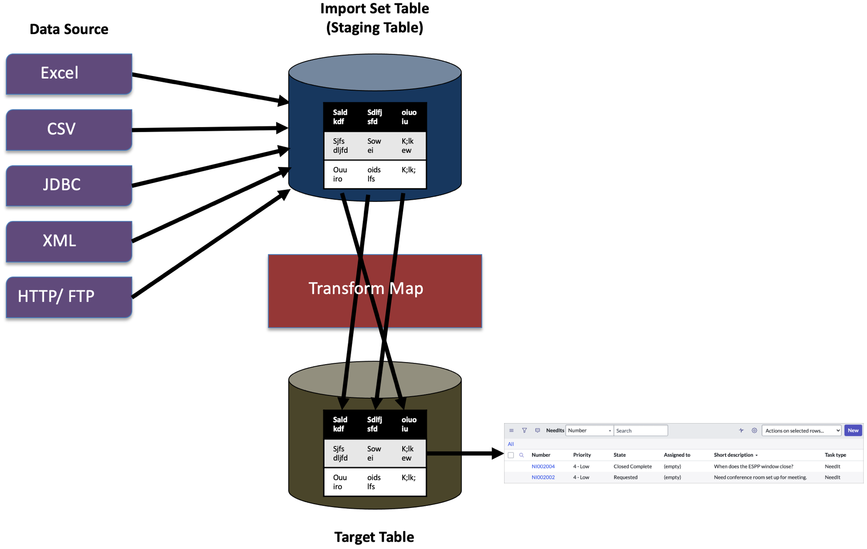
Common Data Import Methods in ServiceNow
Import Sets are a flexible tool that allows bulk data import from various sources like CSV, Excel, or XML files.
IntegrationHub and REST APIs enable real-time data exchange with external systems for dynamic data synchronization.
Data imports can be scheduled or run manually depending on organizational needs and data update frequency.
Notes:
Image source: https://developer.servicenow.com

Slide 4

Preparing Data for Import
Data should be cleaned and validated to prevent errors and ensure consistency in ServiceNow tables.
Mapping external data fields to ServiceNow table fields is a crucial step to maintain data integrity.
Pre-import testing in a sandbox environment helps identify potential issues before affecting live data.
Notes:
Image source: https://www.slidemake.com

Slide 5
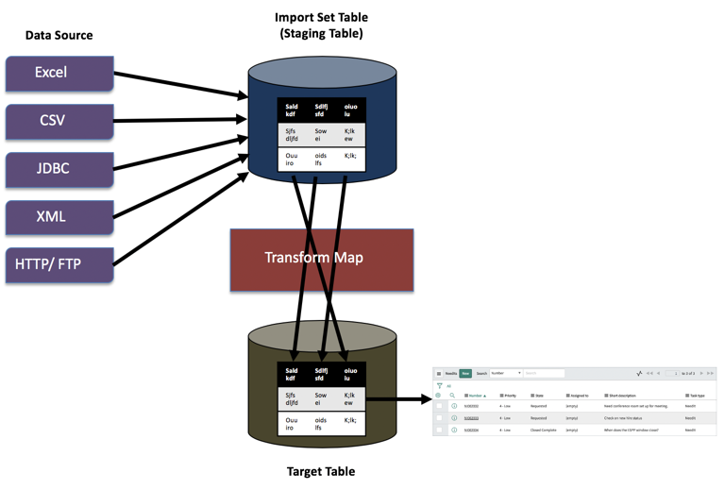
Importing Data into ServiceNow
Use Import Sets to load data and transform it into ServiceNow format using Transform Maps.
Monitor import progress and resolve errors through the Import Log and Error Handling features.
Post-import verification ensures data has been correctly imported and is functioning within workflows.
Notes:
Image source: https://developer.servicenow.com

Slide 6
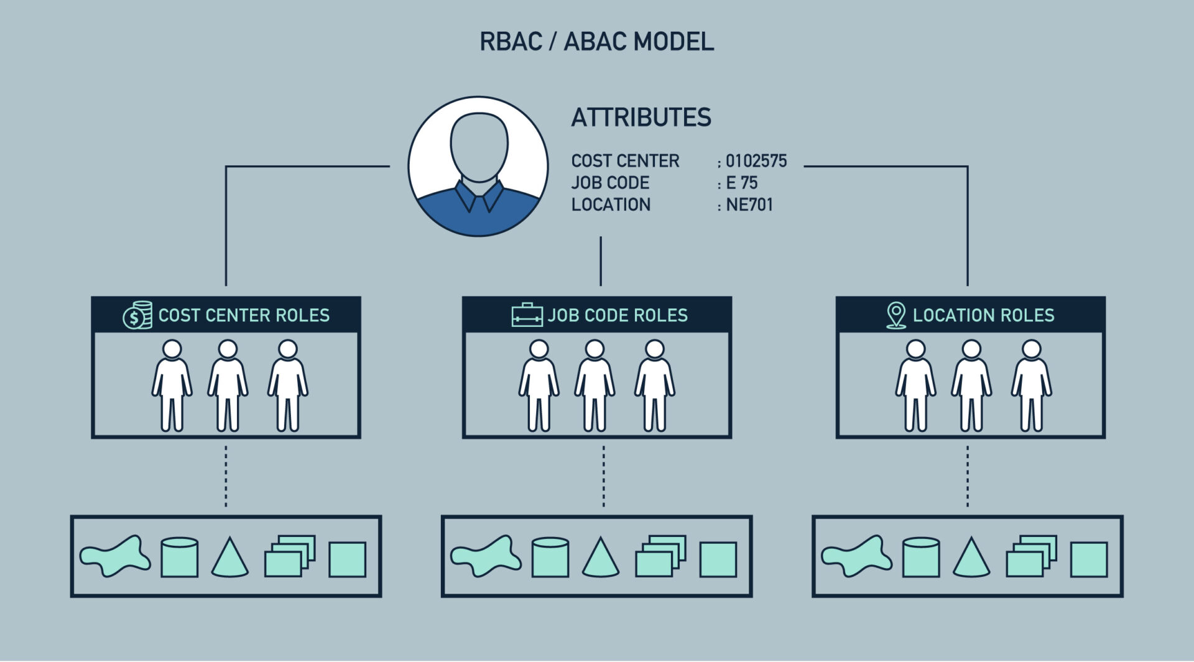
Securing Data in ServiceNow
Role-based access control (RBAC) restricts data access based on user roles and responsibilities.
Data policies and ACLs (Access Control Lists) enforce security at the record and field levels.
Regular audits and reviews help identify and rectify security gaps or unauthorized data access.
Notes:
Image source: https://cyberhoot.com

Slide 7
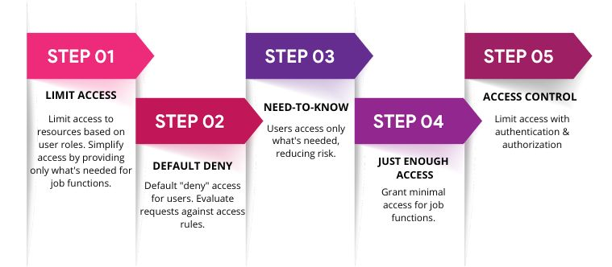
Best Practices for Data Security
Implement the principle of least privilege by granting users only the permissions necessary for their roles.
Encrypt sensitive data both in transit and at rest to prevent unauthorized data interception.
Use multi-factor authentication (MFA) and strong password policies to enhance user account security.
Notes:
Image source: https://bigid.com

Slide 8

Compliance and Data Governance
Maintain audit logs of data import activities and access to ensure accountability.
Establish data governance policies to define standards for data quality, security, and lifecycle management.
Regular training and awareness programs help users understand security best practices in ServiceNow.
Notes:
Image source: https://trainingcred.com

Slide 9
Conclusion and Summary
Effective data importing and security in ServiceNow involve careful planning, execution, and ongoing management.
Utilizing the platform’s built-in tools and best practices helps ensure data integrity and protection.
Continuous monitoring and compliance efforts are vital for maintaining a secure and reliable ServiceNow environment.
Notes:
Image source: https://www.fideltech.com

Slide 10
References
ServiceNow Product Documentation. (2023). Data Import & Security.
ServiceNow Community & Knowledge Base. (2023). Best Practices for Data Security.
ITIL and ServiceNow Security Best Practices. (2023).

